Slide 1
Digital Icebreakers
Breaking the ice online

Slide 2
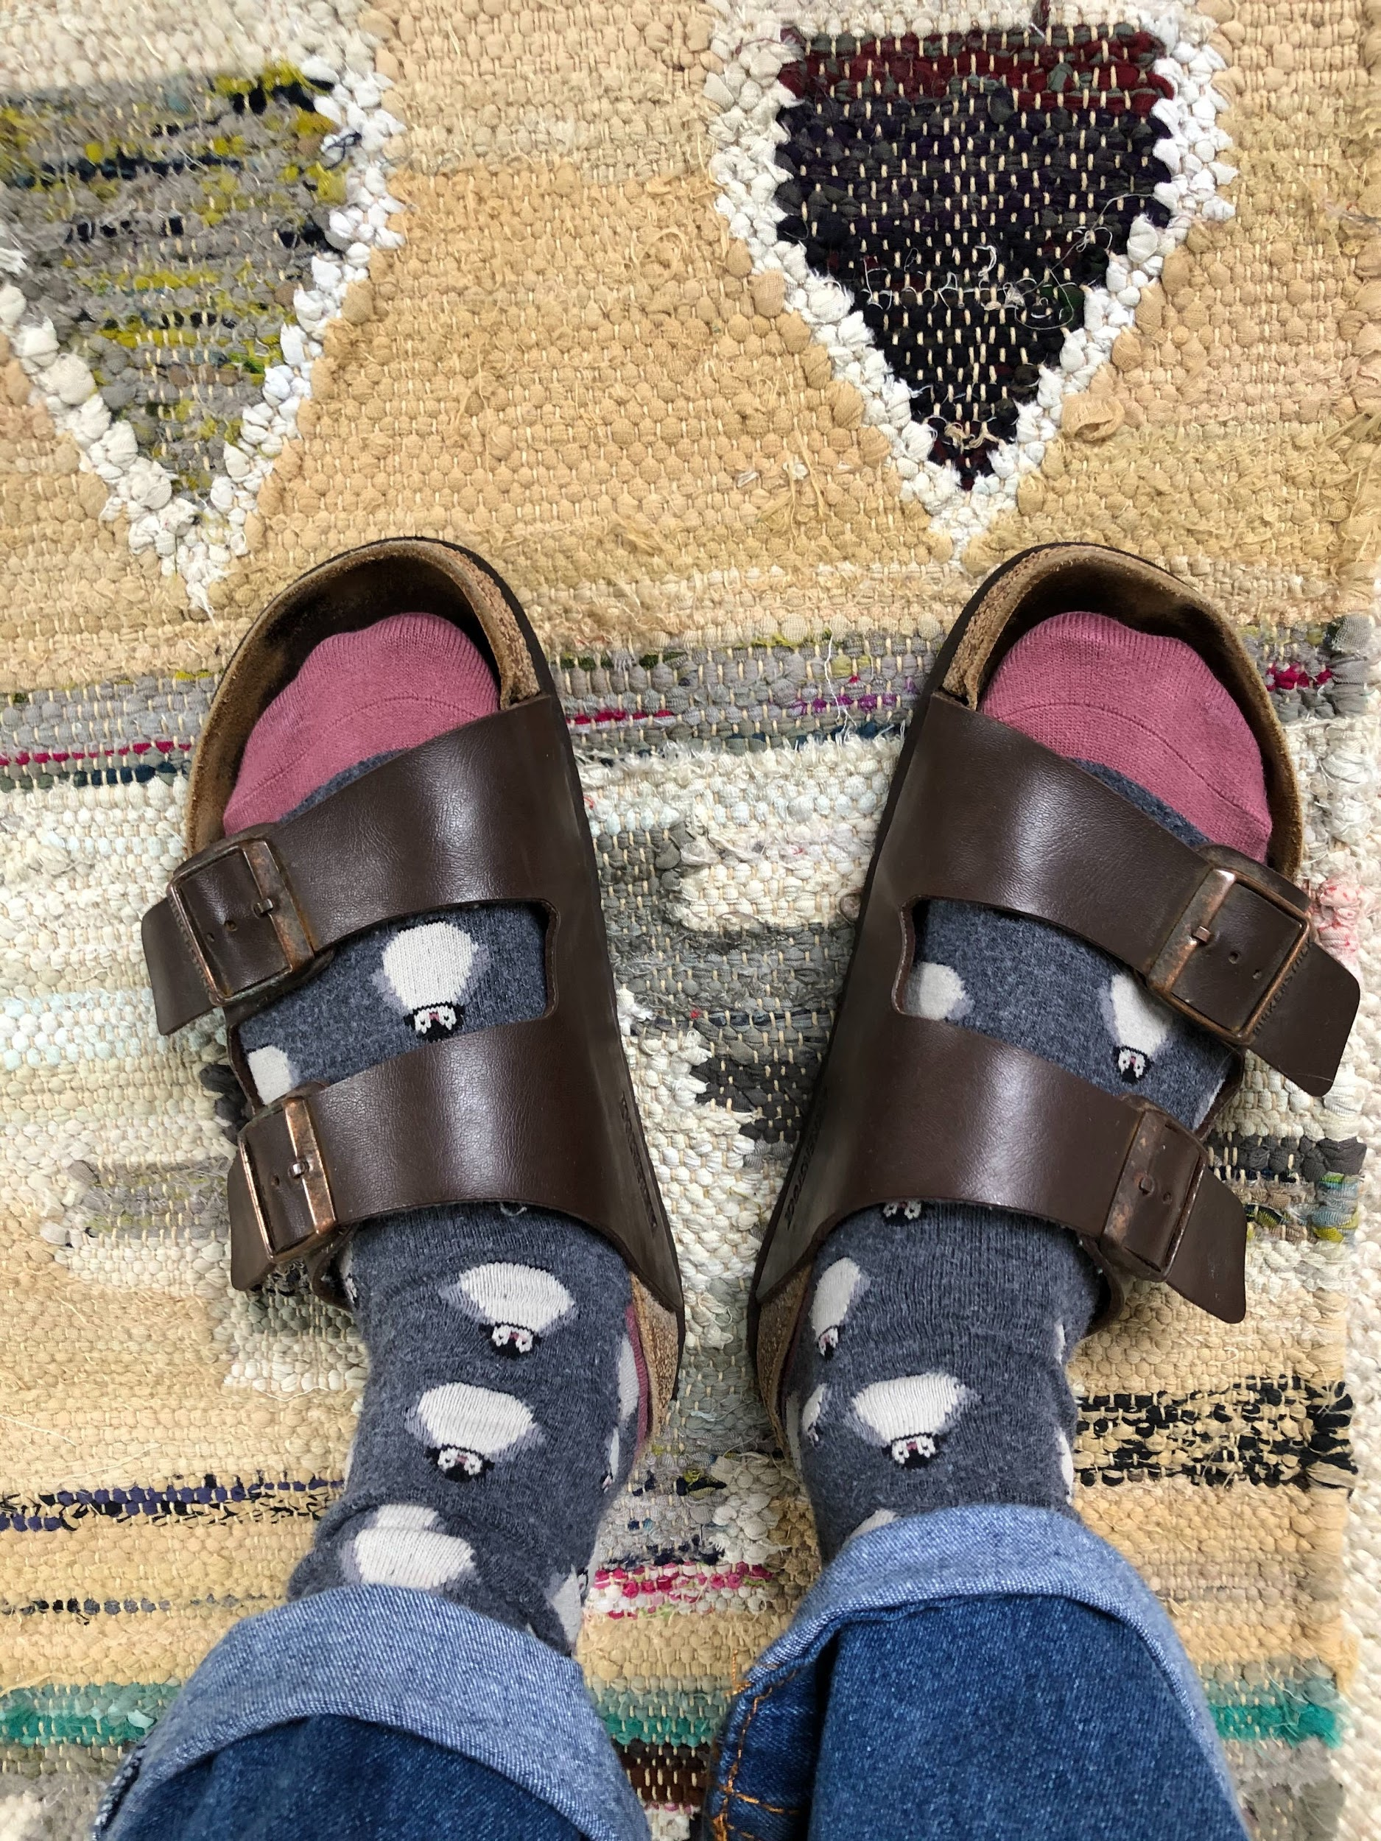
What’s on your feet?
Then, at the start of the meeting, ask each participant to discuss his choice of shoe, and any “story” behind it. For example, one person might be wearing running shoes – and this might lead to a discussion about his hobbies – or sandals, flip-flops or sneakers.
Vary the exercise by asking team members to take a picture of an object on their desks, and getting them to talk about it.

Slide 3
Take a picture of….

Slide 4
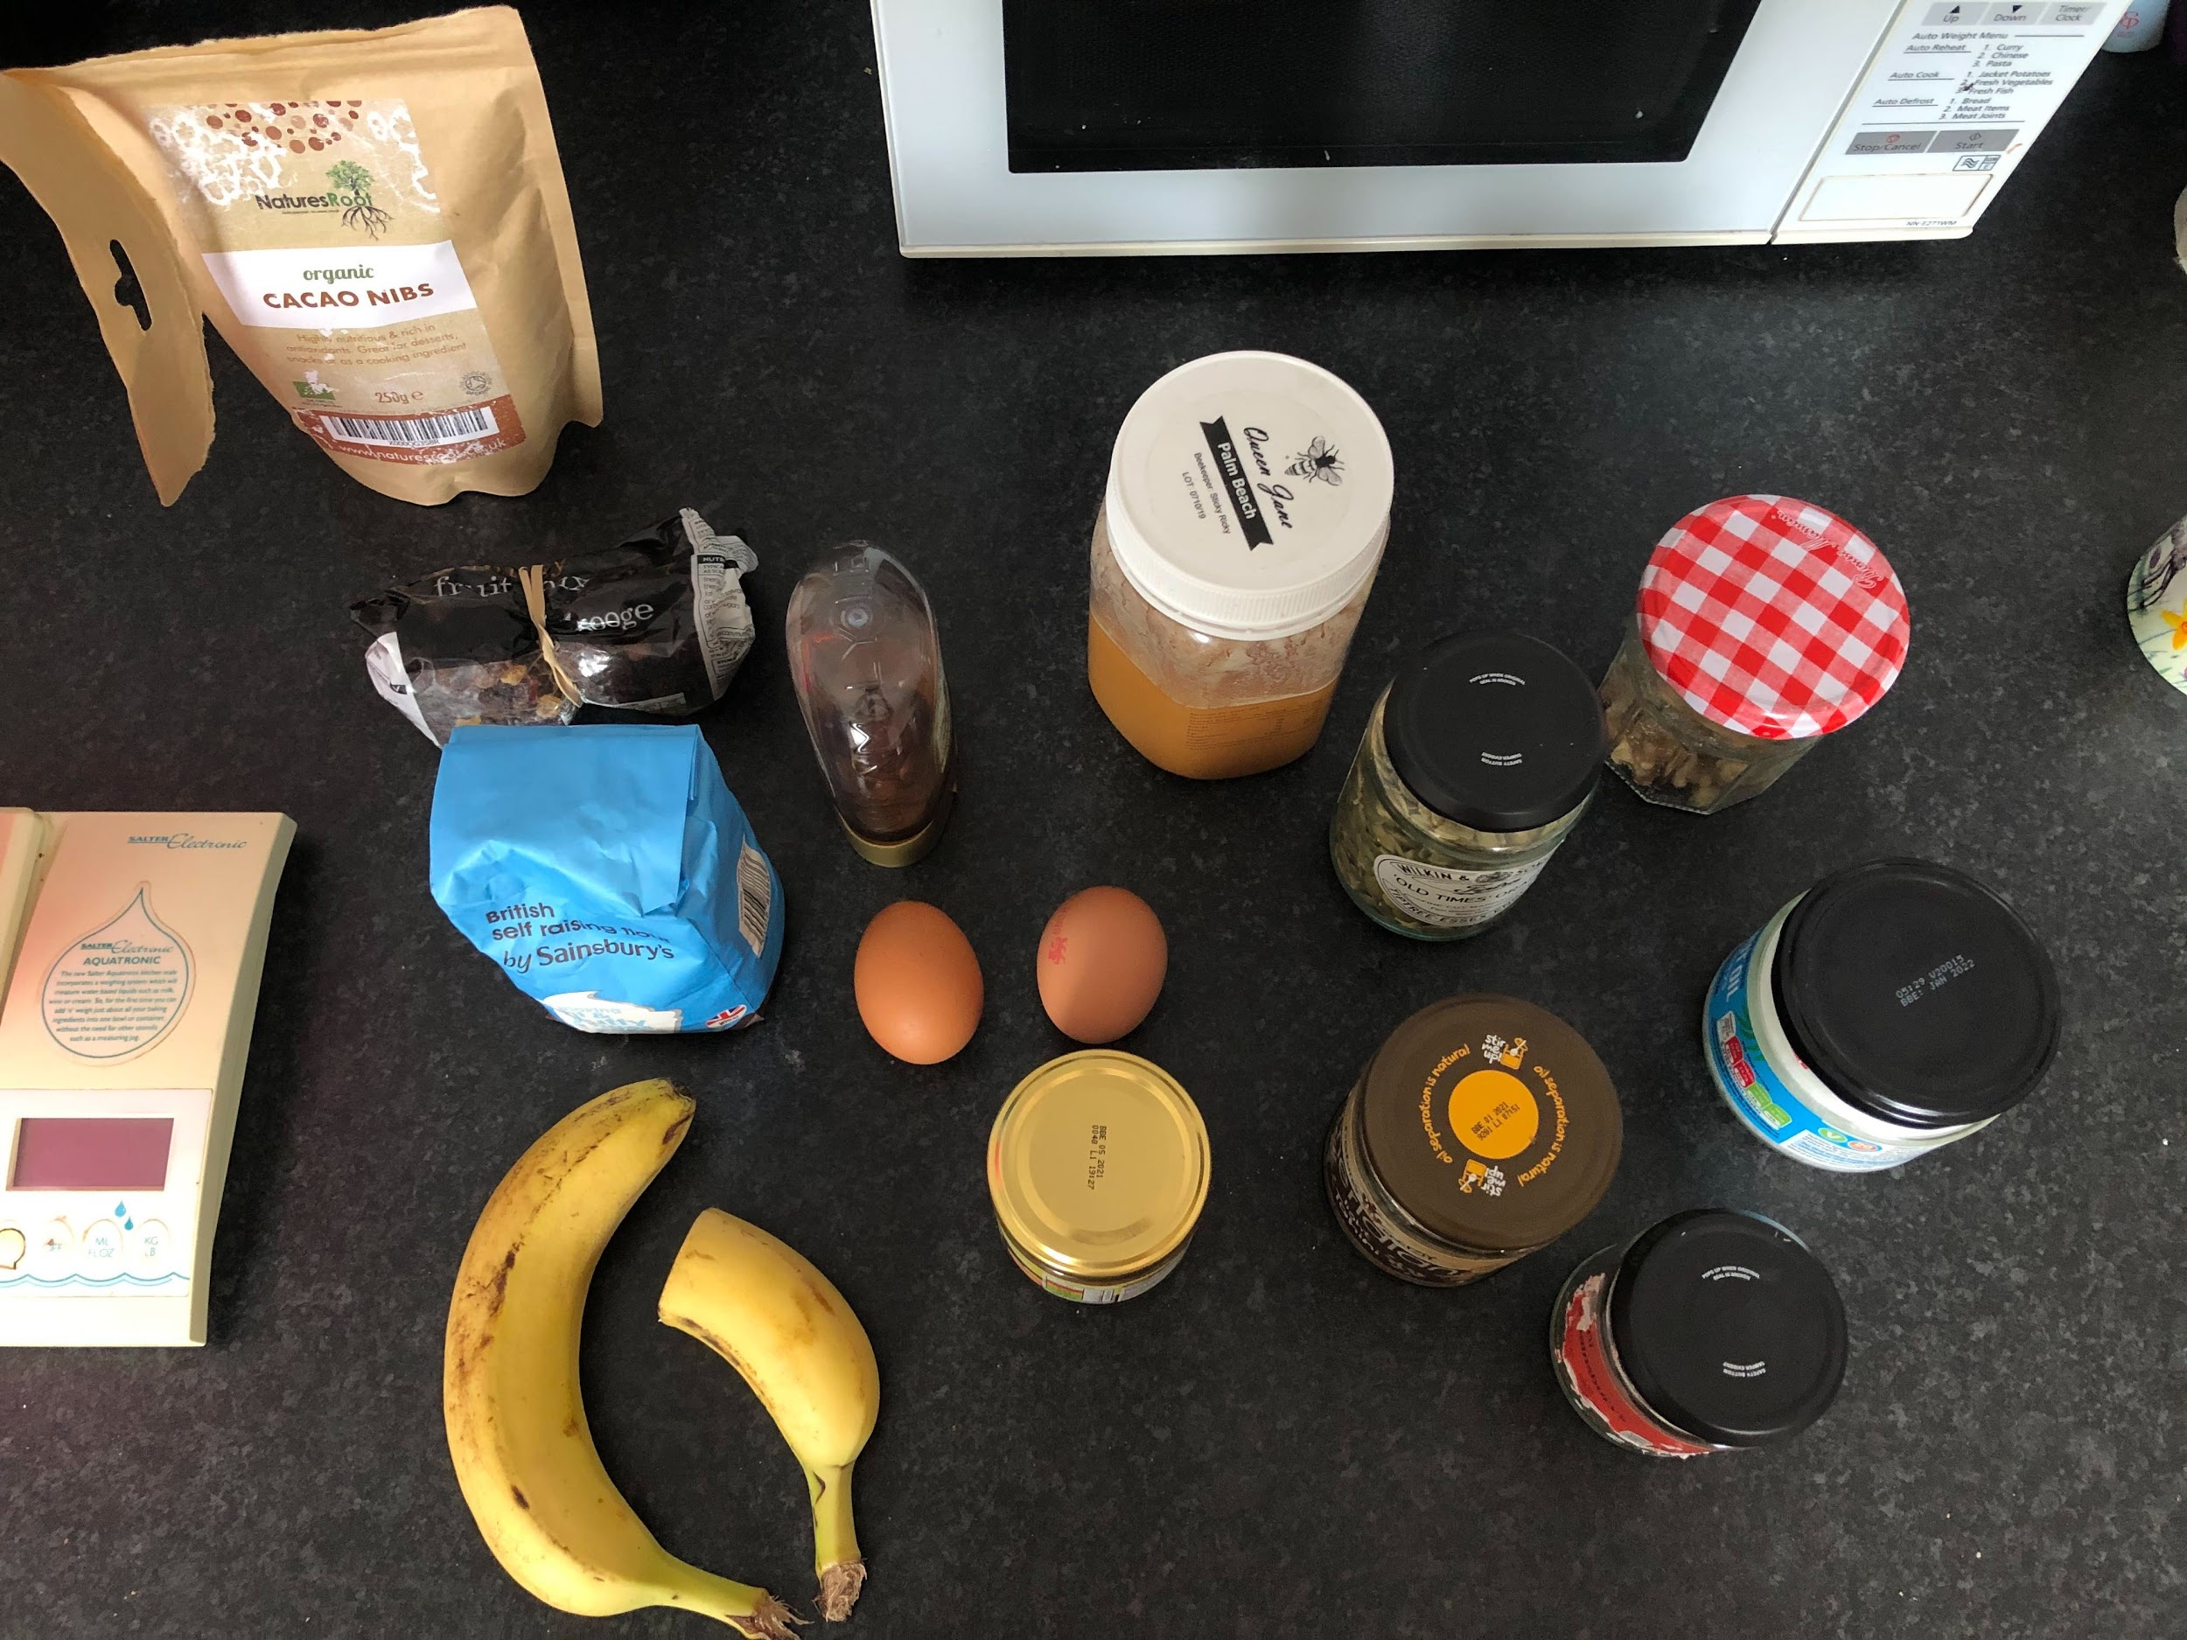
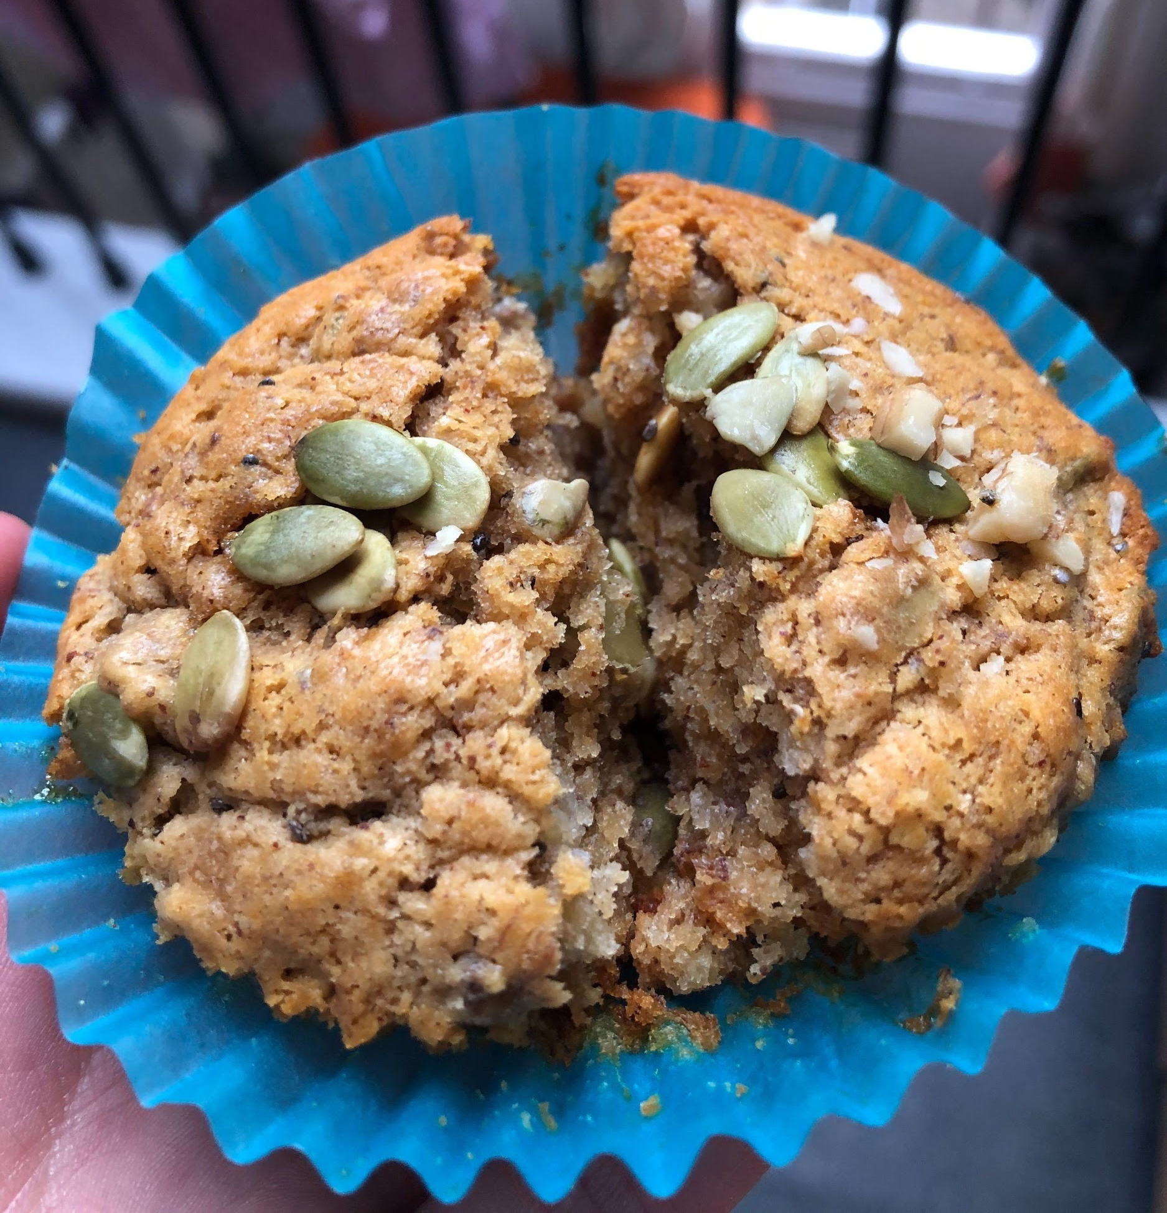
Social Questions
Ask each participant a “social” question. So, you could find out what someone enjoys doing outside of work, or ask if she has a funny story she can share about something that happened to her recently, and so on
-----examples of questions-----
Give an example of something you’ve done this week that you feel proud of.
If you weren’t on this call, what would you like to be doing?
If you could eat any dish right now, what would it be?
If money and time were no object, where would you most like to go on holiday?
“Baking from what I have in my cupboard”

Slide 5
Most Unique
The goal is to find something about you that no one else has in common. It could be a vacation you've been on, an award you've won, or a hobby no one's heard of before.
The group says one-by-one something they think is the most unique, and others will speak up if they've also done that. Once someone finds their own most unique fact, it moves on to the next person. At the end of the game, you should have new facts about everyone, and great conversation starters to ask about at another time.

Slide 6
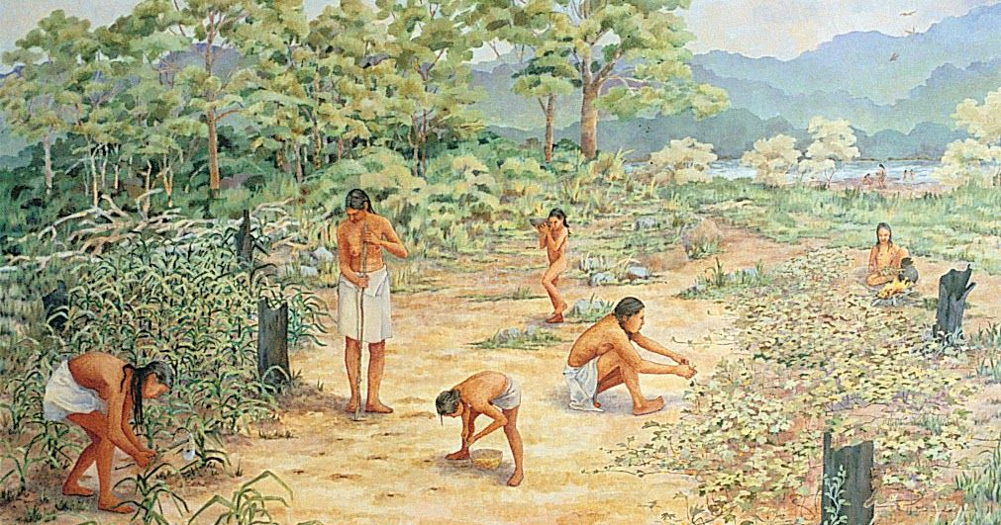
The Time Machine
Ask the following question, to one participant at a time:
“If you were able to travel through time, either forward or backward... :
Where would you go?
If backward, to which time period? Why?
If there was a person you could go back in time and meet, who would it be, and why?
Would you just want to visit and come back, or would you stay?”

Slide 7
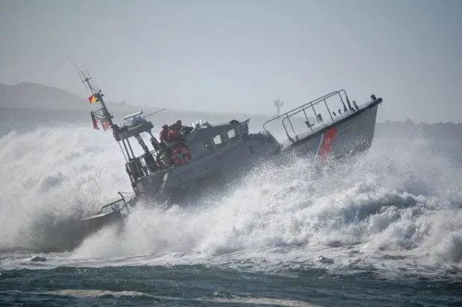
Stormy Seas
Imagine you are on a ship in a stormy sea, what approaches would you apply to get the ship to safety.

Slide 8
Miscomm-puter-unication
Ask the participants to share their most embarrassing mishap using a computer.
Share your own experience, for example, replying to the wrong person in an email. This will loosen them up and cause a few to chuckle before embarking on a whole new way of thinking…using technology instead of paper and pen.

Slide 9
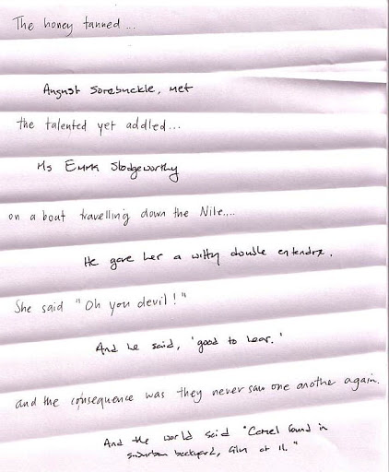
Three Words
Ask participants to write a story together.
The rule is that everyone is only allowed to put up three words.
They are allowed to post again if at least one other participant has put up three words.
At the end of the exercise you can summarise the whole story of even read it and post it as an audio file or a video.

Slide 10
Spin a Tale
Assign numbers to each participant, starting with n°1.
Ask person n°1 to start telling a story in a direct message to person n°2 (maximum two lines).
Once they receive the message, person n°2 continues the story in another direct message to person n°3 (without including the first part), and so on...
In the end, everyone needs to read out the story in the order you started.

Slide 11
Gratitude Jar

Slide 12
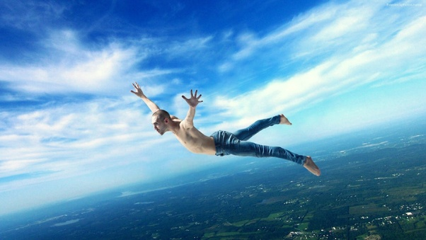
Superpowers
If you could have one superpower, what would it be and why?

Slide 13
Lost in Space
Participants pretend they are living on a space station for a year. Suddenly, the station is malfunctioning and they have fifteen minutes to gather only five items to take with them on the evacuating space shuttle.
This is not a time for deep thought. Participants are instructed to quickly type out the five items they are taking with them.
Once all participants have enter their items on their initial posts, peers read through the entries to find similarities and/or curiosities.
Participants post replies to comment and ask questions about the reasoning behind choosing the items. Give the group categories of technology, personal, and survival to start their explanation.

Slide 14
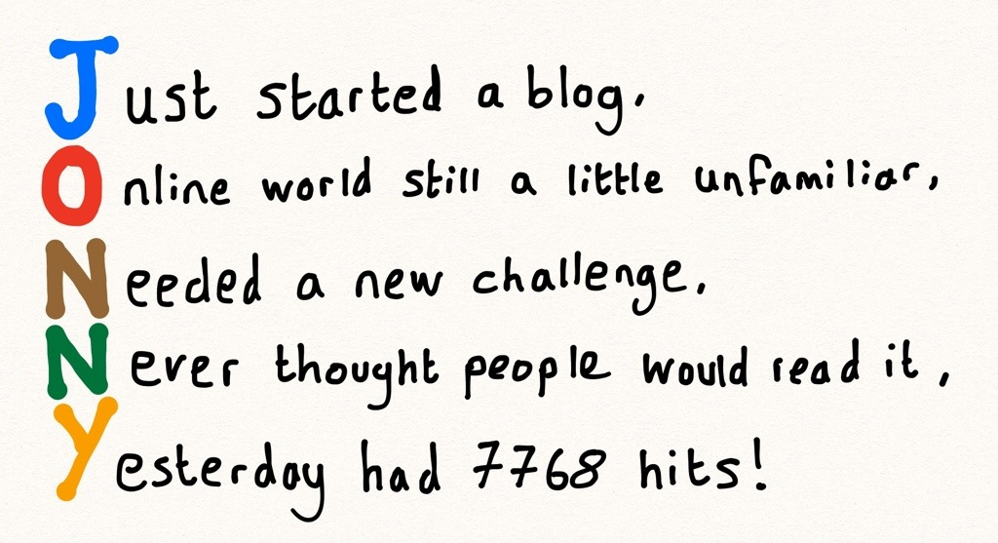
Acrostic Poem
Writing their name vertically, participants use each letter to start a line, or be the main word in a line, that describes something about themselves.
Peers review all poems and try to remember details about each colleague.
The facilitator then creates a short quiz using the statements posted in different poems.

Slide 15
Two Truths and a Lie
Ask each participant to write down three statements about themselves. Use one sticky note per statement. Make sure one of them is a lie and the other two are true.
Each member can vote for which statement they think is the lie by placing their coloured dots next to the lie.
Once everyone has voted, reveal the correct answer and give team members the option to ask follow-up questions about any crazy statements!

Slide 16
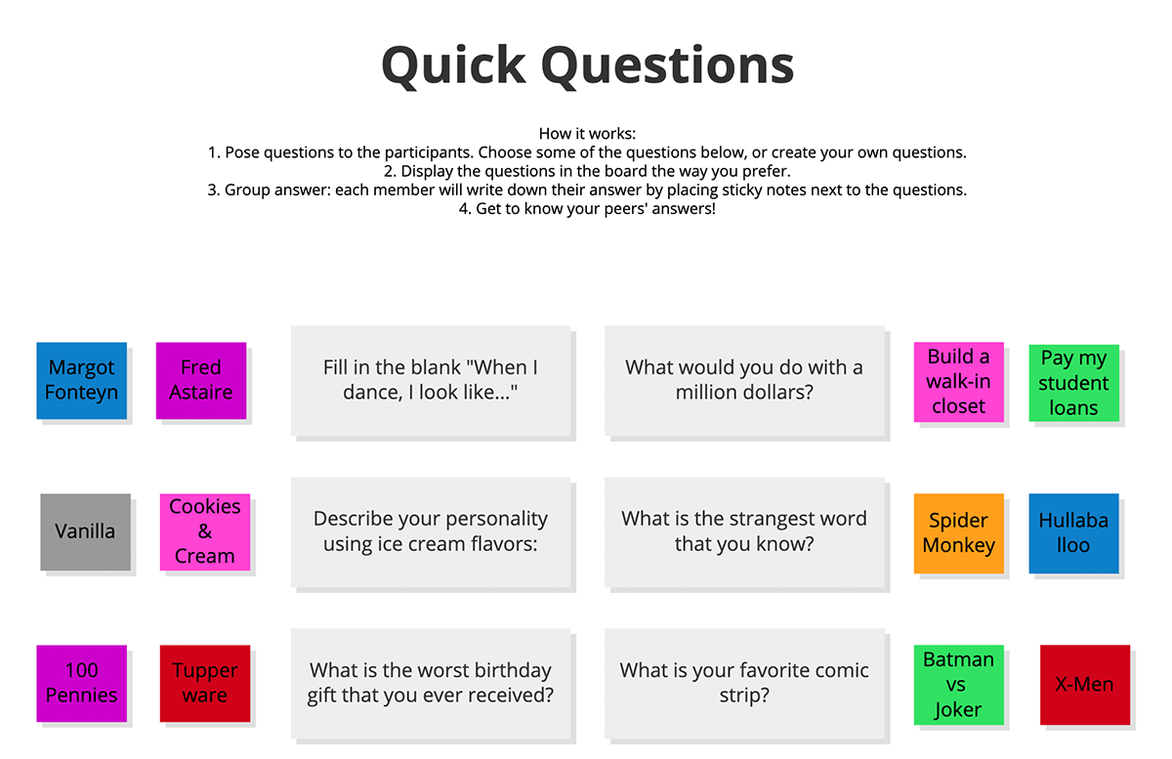
Quick Questions

Slide 17
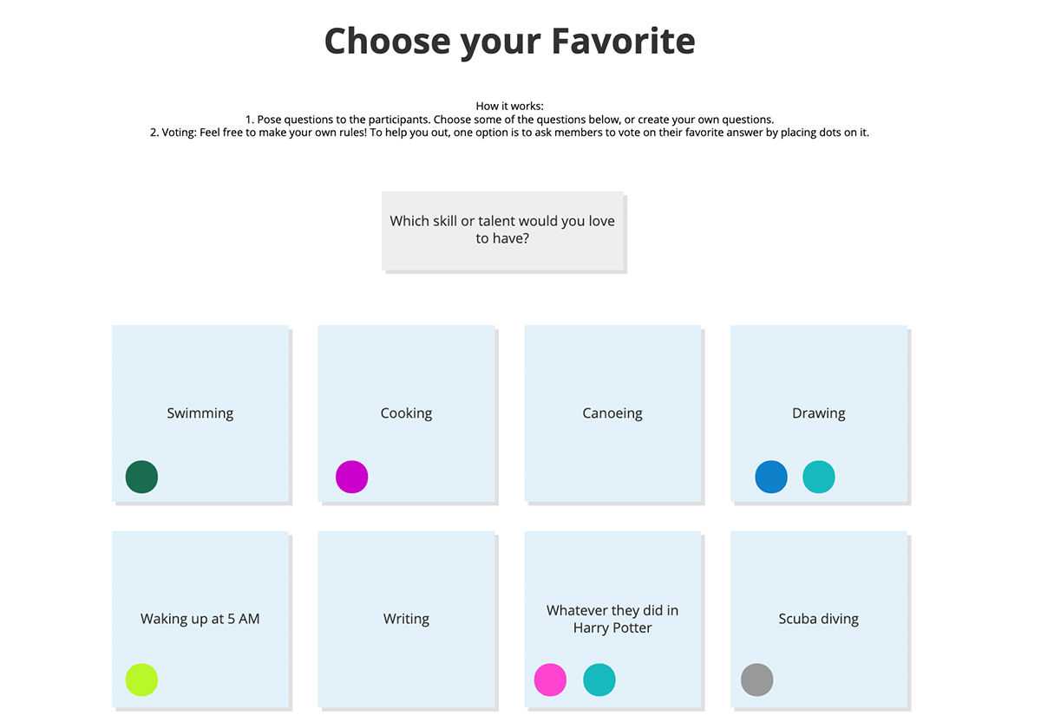
Choose your favourite…...

Slide 18
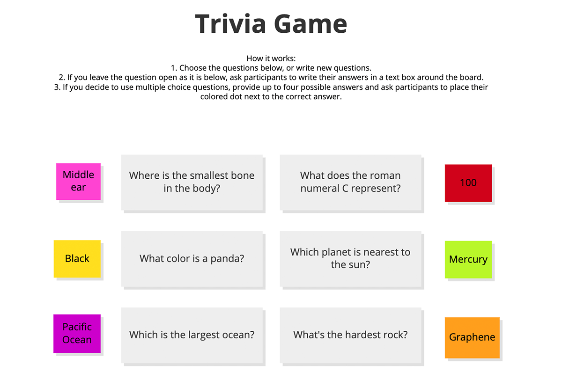
Trivia Game

Slide 19
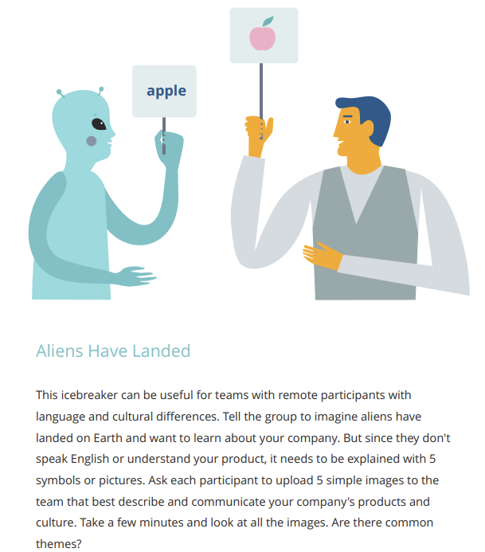
Aliens Have Landed
Notes:
https://miro.com/blog/wp-content/uploads/2017/06/Chapter_4.pdf

Slide 20
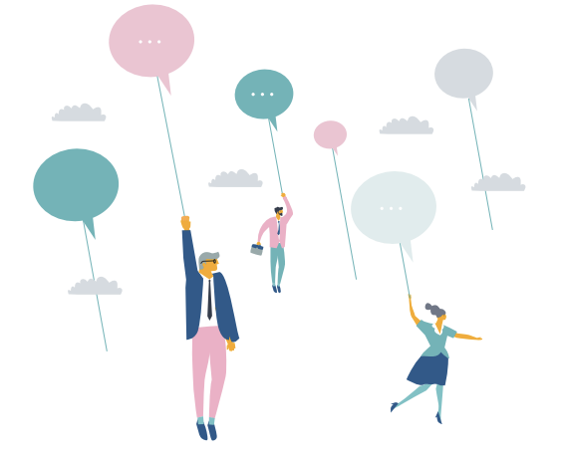
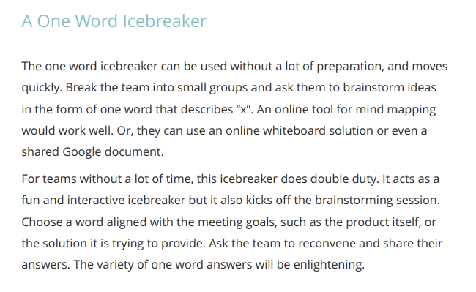
One Word Icebreaker

Slide 21
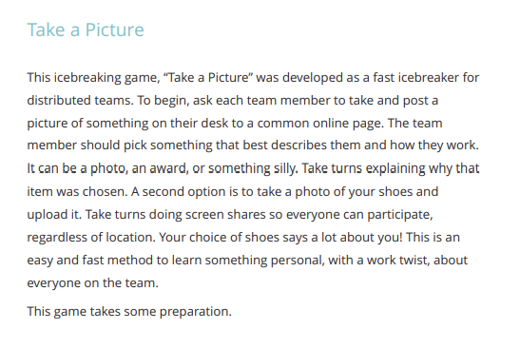
Take a Picture

Slide 22
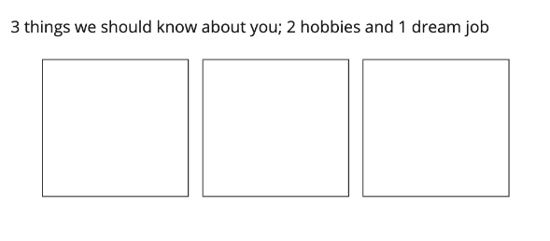
2 hobbies, 1 dream job
Using emojis in Miro

Slide 23
Write a story
Using Miro emojis

Slide 24
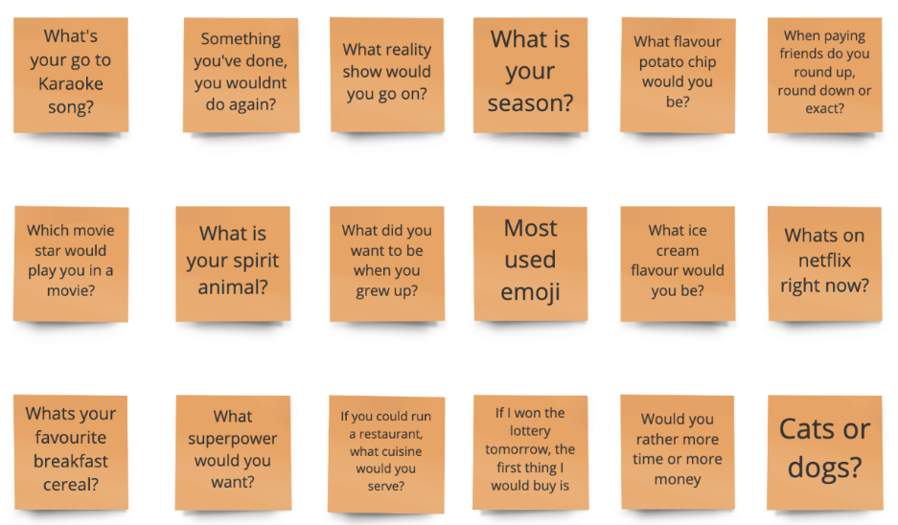
Short Ice-breakers

Slide 25
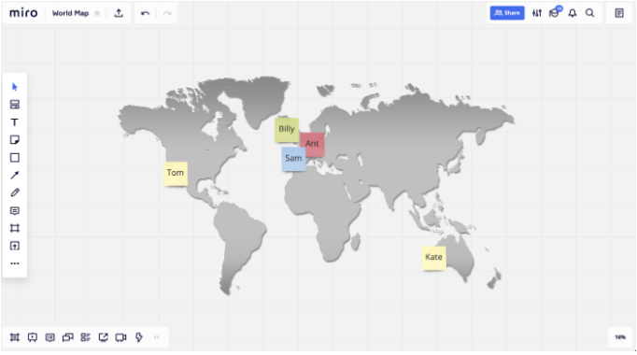
If you could be anywhere in the world right now
Put an image of the world in the centre and get each person to put their name on the part of the world that they would rather be — it can be great fun to visualise!

Slide 26
Picture Charades
Like Charades but with a remote twist where you can only use images to explain whatever famous movie, book, etc they pick. Similar rules, no talking, and the images cannot be directly from the movie or book.
Maybe put a limit of 5 images.

Slide 27
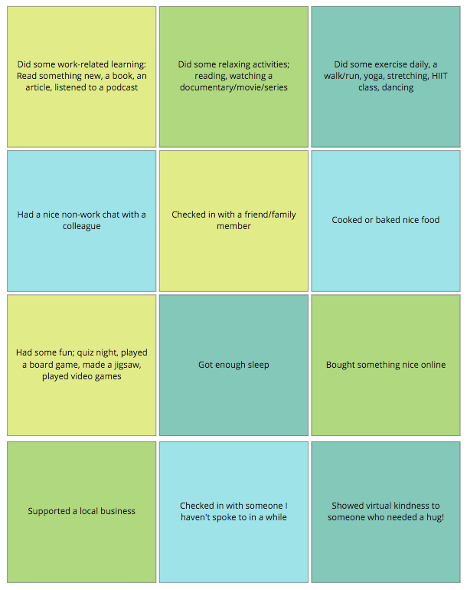
Healthy Habits Bingo
Ask everyone to place and emoji or tick beside the activities they have participated in.

Slide 28
Would you rather?

Slide 29
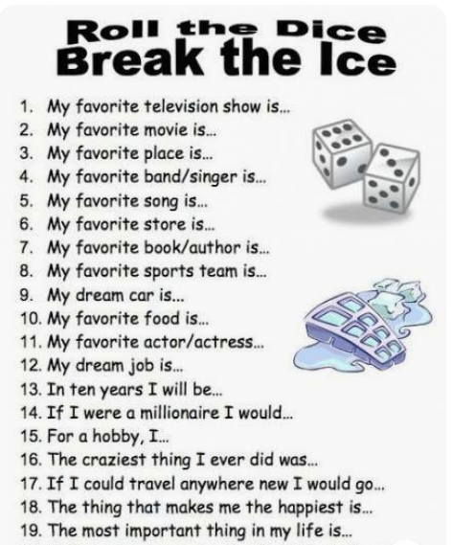
Roll
the
Dice

Slide 30
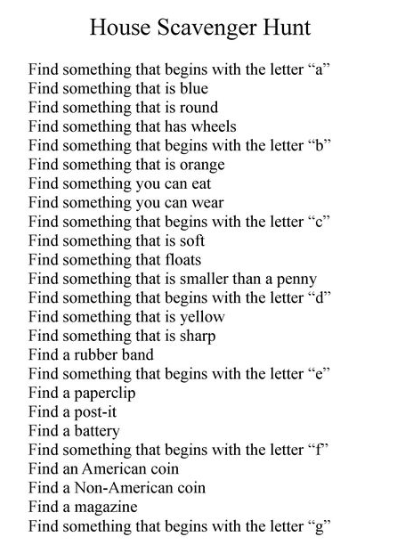
House Scavenger
Hunt

